Slide 1
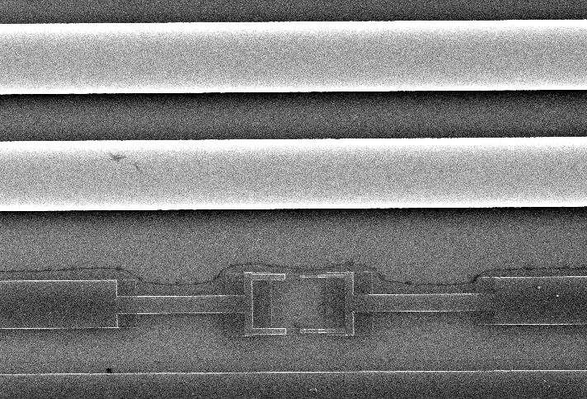
fluxline
groundplane
20 μm

